Slide 1

Exploring Pet Ownership and Its Impact on Psychological Well-Being and Eating Behaviors
Course: STAT 496
By: Param Nijjer
Date: 31st March 2025

Slide 2

Data Description
Initial Sample: 686 participants
Final Sample: 644 participants (42 removed due to missing data or inconsistencies)
Data Collection: Self-reported data via online questionnaires
Imputation: Missing values were imputed for participants with 75%+ completion rate (average score method)

Slide 3

Key Variables
Independent Variable
Pet Ownership:
1 for pet owners
0 for non-owners
Dependent Variables
Disordered Eating Behaviors (EDI-3)
Drive for Thinness (DT)
Body Dissatisfaction (BD)
Bulimia (B)
Psychological Well-Being
Depression: Measured using BDI
Anxiety: Measured using BAI
Mood: Measured using PANAS
Loneliness: Measured using RULS-6
Pet Attachment: Measured using LAPS, AAS, and PAS

Slide 4
Literature Review
High pet attachment linked to emotional distress and mental health challenges (ScienceDirect, 2023)
Strong bonds with pets may increase anxiety and stress (NIH, 2022)
Over-reliance on pets as coping can lead to mood instability and depression (Frontiers in Psychology, 2023)
Higher pet attachment associated with disordered eating behaviors (ScienceDirect, 2023)

Slide 5
Research Question 1
RQ1:
Is pet ownership associated with disordered eating behaviors, including drive for thinness (DT), body dissatisfaction (BD), and bulimia (B)?
Hypothesis:
Pet owners will have fewer disordered eating behaviors due to the positive psychological impact of pet ownership (e.g., emotional support and companionship).

Slide 6
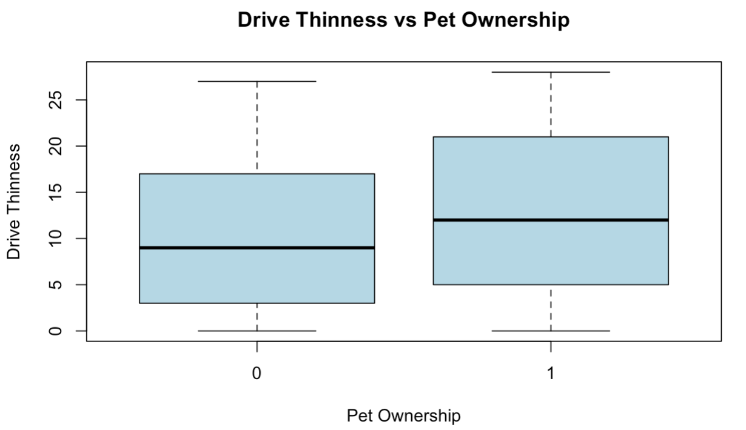
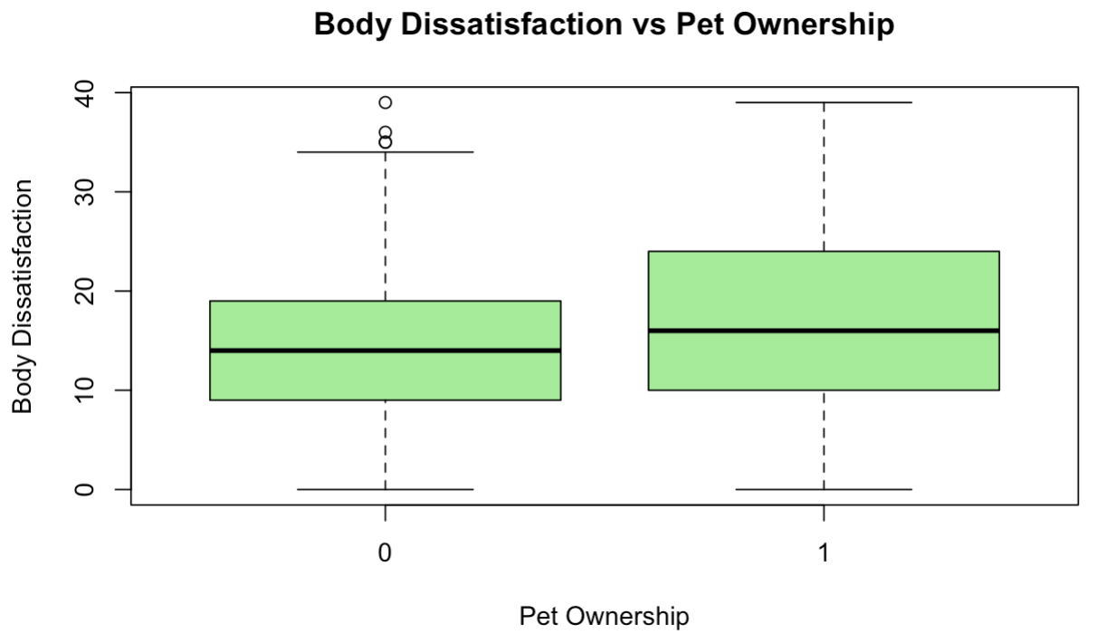
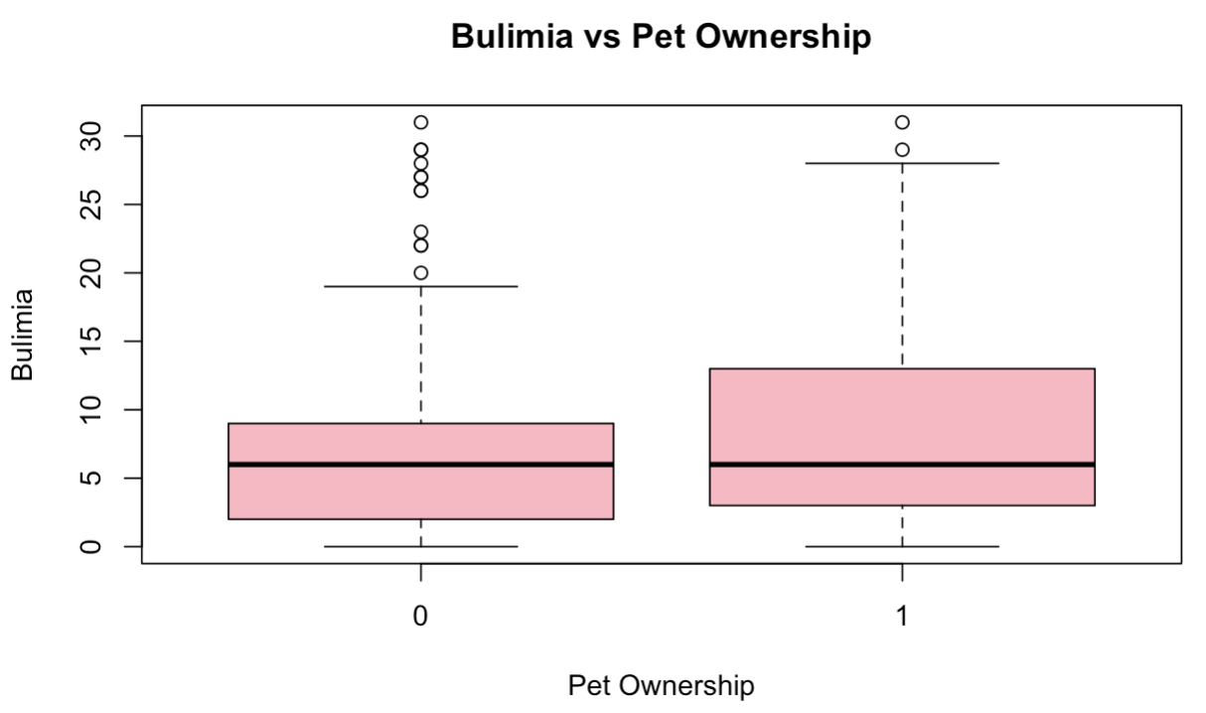
BOX-PLOTS

Slide 7
Results
Results:
Significant positive associations between pet ownership and DEBs (Drive for Thinness, Body Dissatisfaction, Bulimia).
Statistically significant p-values (all < 0.005).
Small effect sizes (R²):
Drive for Thinness: 0.01743
Body Dissatisfaction: 0.01905
Bulimia: 0.01297
Low explanatory power – pet ownership alone has minimal impact on DEBs.
Although the data shows a significant positive association, the small effect sizes highlight that pet ownership alone is not a strong predictor of disordered eating behaviors.

Slide 8
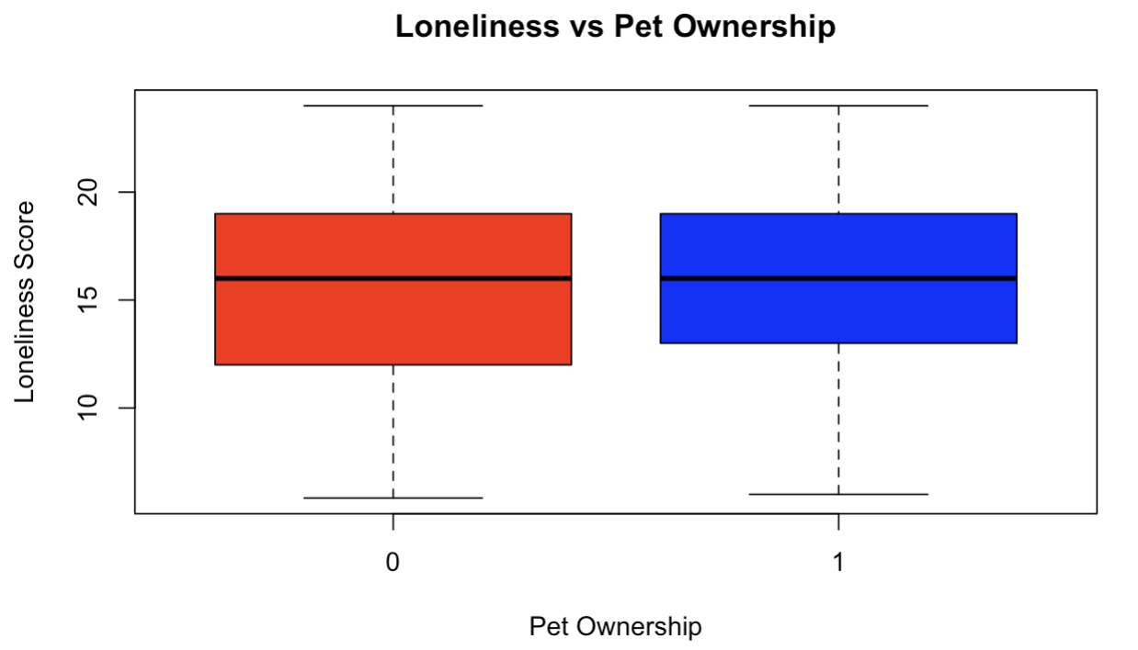
Research Question 2
RQ2:
Does pet ownership affect psychological well-being (depression, negative mood, positive mood, loneliness, and anxiety)
Hypothesis:
Pet ownership will have a significant impact on psychological well-being, with pet owners demonstrating lower levels of depression and anxiety, and higher levels of positive mood compared to non-owners.

Slide 9
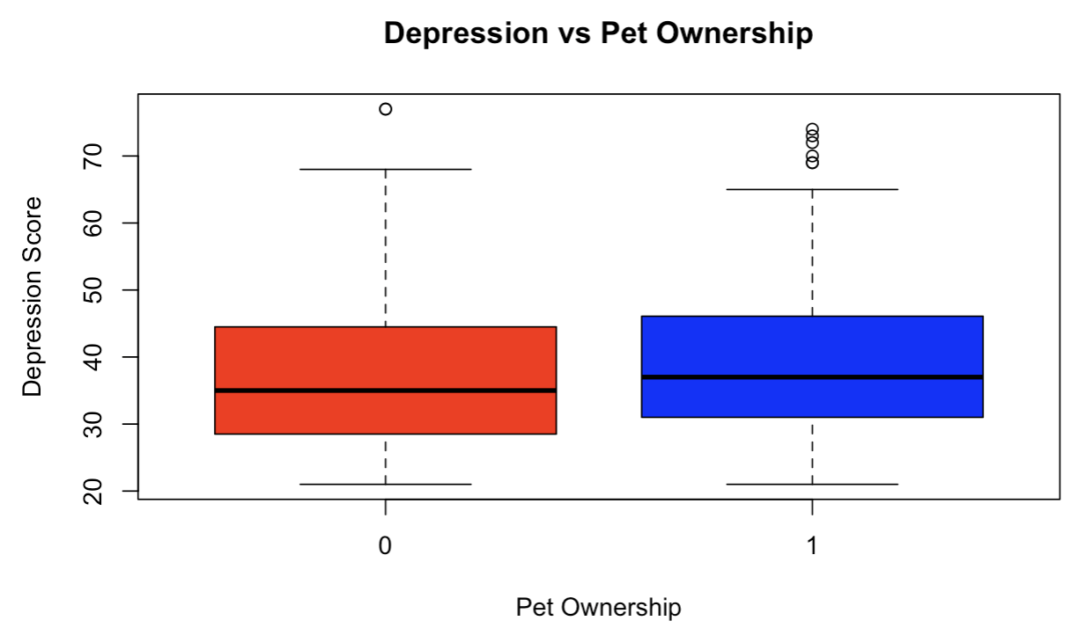
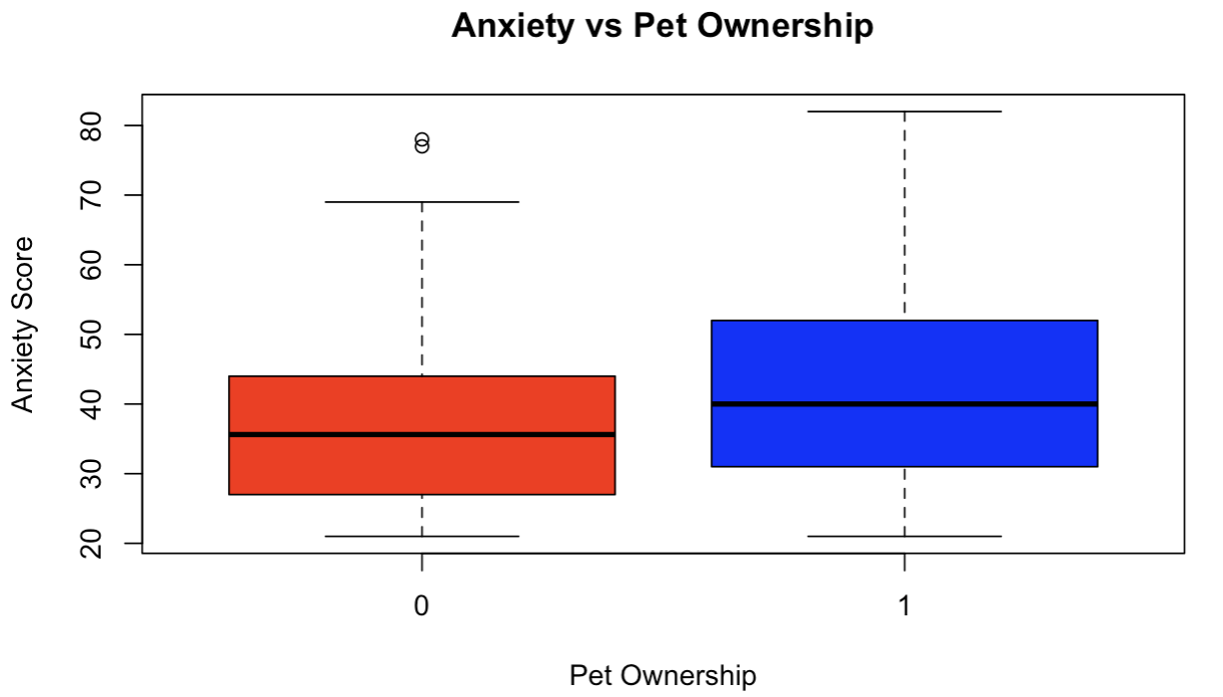
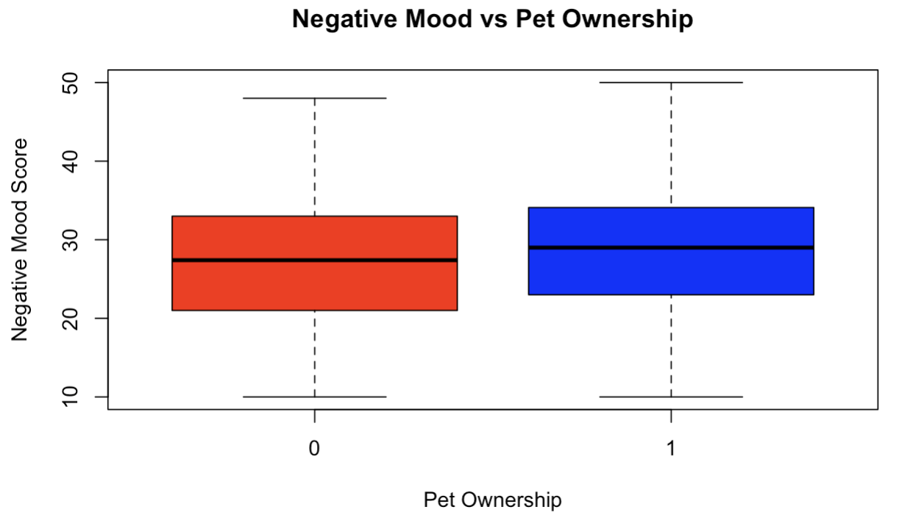
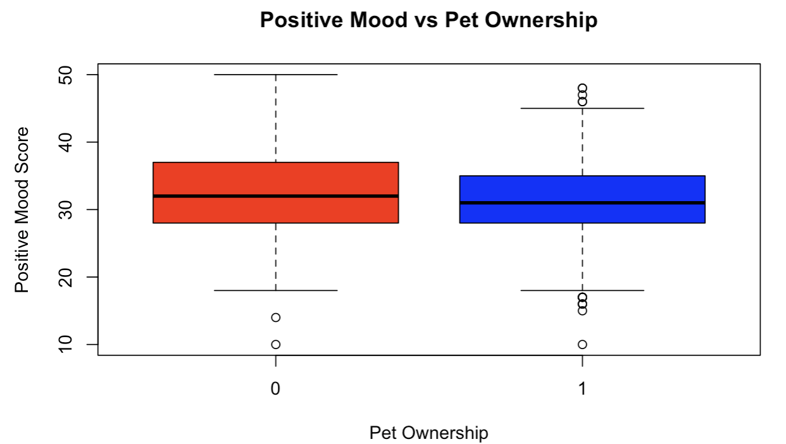
BOX-PLOTS

Slide 10
Results
Significant Results:
Depression: Significant difference (p < 0.001) – pet owners had higher depression scores.
Anxiety: Highly significant difference (p < 0.001) – pet owners had higher anxiety levels.
Negative Mood: Significant difference (p = 0.0158) – pet ownership linked to higher negative mood.
Not Significant Results:
Positive Mood: Marginal result (p = 0.057) – no strong evidence of an effect.
Loneliness: Not significant (p > 0.05) – no difference between owners and non-owners.
Hypothesis was partially supported

Slide 11
Research Question 3
RQ3:
Does pet owner’s attachment relate to psychological well-being indicators, including depression, anxiety, positive mood, negative mood, and loneliness
Hypothesis:
It was hypothesized that a stronger attachment to pets would be positively correlated with lower depression, anxiety, and loneliness, and higher positive mood.

Slide 12
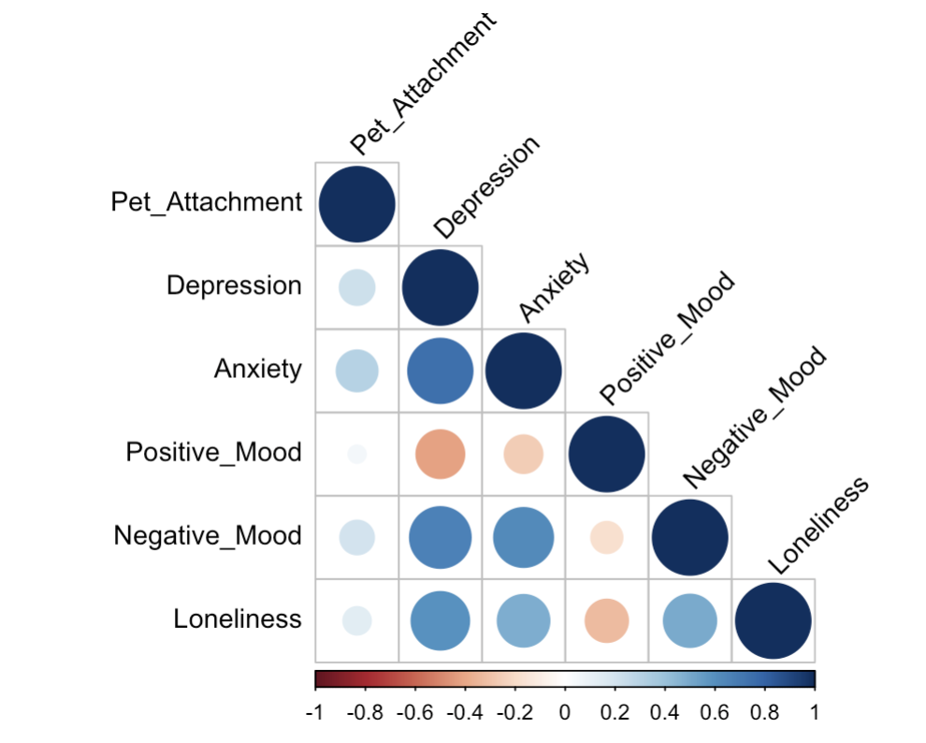
Research Question 3 CON’T
Positive correlation between pet attachment &
Anxiety (r = 0.30) p-val < 0.05
Depression (r = 0.22) p-val < 0.05
Negative mood (r = 0.21) p-val < 0.05
Loneliness (r = 0.14) p-val < 0.05
No significant correlation with positive mood (r = 0.06) p-val > 0.05
Interpretation:
Stronger pet attachment is linked to higher distress, not lower
Hypothesis not supported
Pets may not buffer mental health as expected

Slide 13
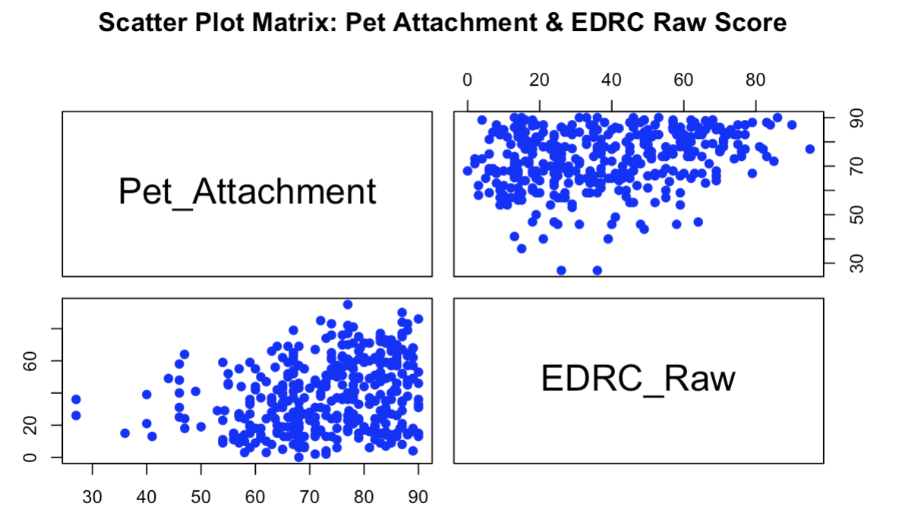
Research Question 4
RQ4:
Does a pet owner's attachment to their pet relate to disordered eating risk (measured by EDRC_raw score)
Hypothesis:
Individuals with higher pet attachment will have lower eating disorder risk (EDRC) due to emotional support and companionship.

Slide 14
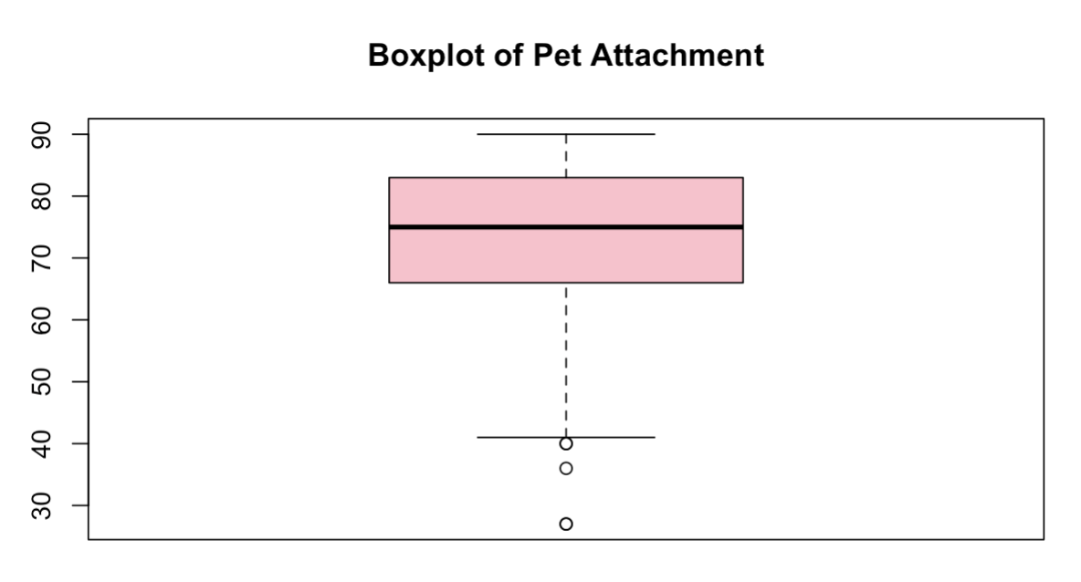
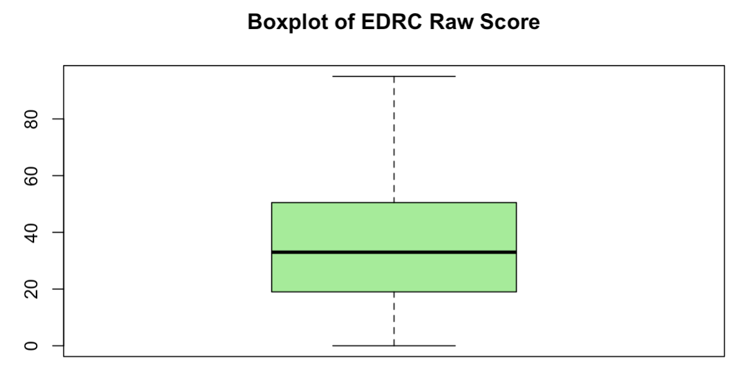
Research Question 4 CON’T
Results:
Scatter Plot: Positive correlation between pet attachment and EDRC (r = 0.257, p < 0.001)
Weak to moderate correlation, statistically significant but not strong
Higher pet attachment unexpectedly linked to higher EDRC risk
Boxplot (Pet Attachment):
High levels of attachment reported
Slightly skewed left with a few low outliers
Boxplot (EDRC Raw Score):
Wide variability in eating disorder risk
No clear clustering, indicating that attachment alone does not explain risk variation.

Slide 15
Research Question 5
RQ5: Does pet ownership indirectly affect eating disorder risk (EDRC_Raw) through depression and negative mood?
Hypothesis: Pet ownership increases EDRC risk indirectly by increasing depression and negative mood.

Slide 16
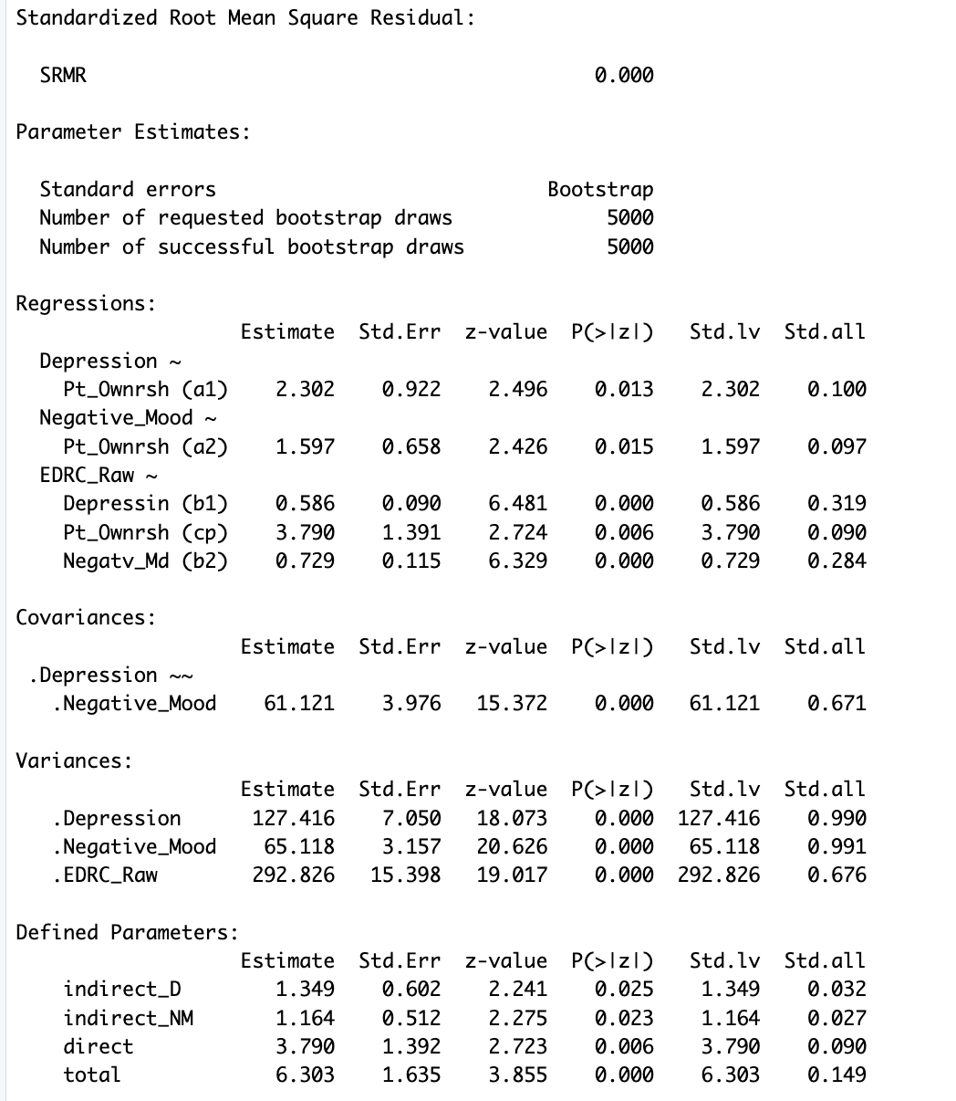
Research Question 5 CON’T
Direct Effects:
Pet ownership → higher depression (p = 0.013)
Pet ownership → higher EDRC_Raw scores (p = 0.007)
Mediation Effects:
Depression (p = 0.001) and Negative Mood (p < 0.001) significantly mediate the relationship
Pet ownership influences EDRC through these psychological pathways
Total Effect:
Combined direct + indirect effect is significant (p = 0.000)
Conclusion: Hypothesis supported
Psychological factors (depression, negative mood) explain how pet ownership is linked to increased EDRC

Slide 17
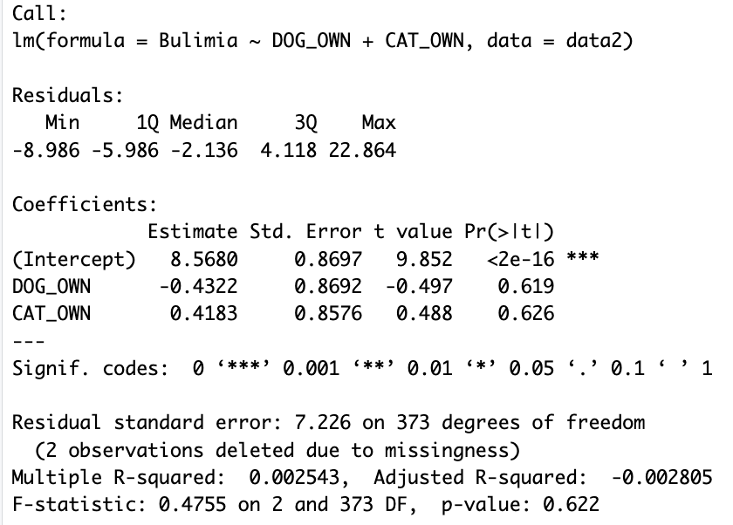
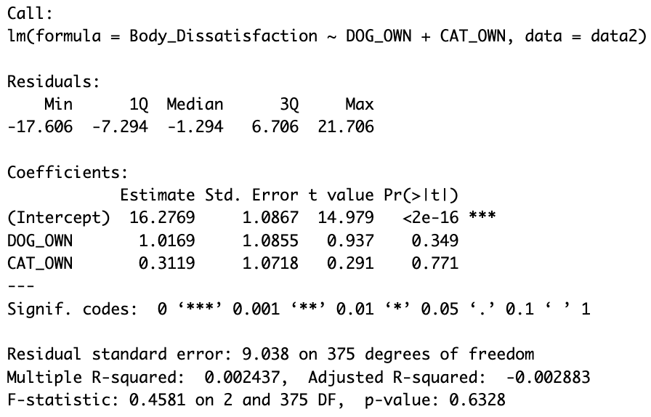
Explanatory Analysis
Analysis: Linear regression was conducted to examine whether the type of pet owned (dog or cat) predicts disordered eating behaviors.
Key Findings:
Pet type was not a significant predictor for any outcome (p > 0.05).
All models had very low R² (0.001–0.002), showing weak explanatory power.
Suggests pet type does not influence eating disorder risk.

Slide 18
Conclusions
Contrary to Expectations:
Pet ownership was associated with higher disordered eating risk and negative psychological outcomes.
Hypothesis suggesting positive mental health effects of pet ownership was rejected.
Key Findings:
Significant positive correlation between pet attachment and eating disorder risk (EDRC).
Mediation effects: Depression and negative mood partially mediated the relationship between pet ownership and eating disorder risk.
Mixed Psychological Outcomes: While some positive mood improvements were noted, depression and negative mood increased.
Implications:
Highlights the complexity of pet ownership's psychological impact.
Suggests potential emotional dependence and coping mechanisms in some individuals.

Slide 19
References
Ståhl, A., Salonen, M., Hakanen, E., Mikkola, S., Sulkama, S., Lahti, J., & Lohi, H. (2023). Pet and owner personality and mental wellbeing associate with attachment to cats and dogs. iScience, 26(12), 108423. https://www.sciencedirect.com/science/article/pii/S2589004223025002
Chin, B. N. (2025, March 11). Worry too much about whether your pet loves you back? You’re more likely to have this health issue. New York Post. https://nypost.com/2025/03/11/health/worrying-about-whether-your-pet-loves-you-linked-to-health-issue/
Lass-Hennemann, J., Schäfer, S. K., Sopp, M. R., & Michael, T. (2022). The relationship between attachment to pets and mental health: The shared link via attachment to humans. BMC Psychiatry, 22, 586. https://pmc.ncbi.nlm.nih.gov/articles/PMC9441033/
Marcial-Modesto, D., Chin, B. N., Casserly, E. D., Parsons, S. M., & Feeney, B. C. (2023). Pet ownership and mental health in United States adults during COVID-19. Frontiers in Psychology, 14, Article 1217059. https://www.frontiersin.org/journals/psychology/articles/10.3389/fpsyg.2023.1217059/full?utm_source=chatgpt.com#ref27

